Slide 1
Hardware System Design Class Overview
March 17, 2020
Sungjoo Yoo
Computing Memory Architecture Lab.
CSE, SNU
http://cmalab.snu.ac.kr

Slide 2
Notice: Online Lecture/Lab
At least, in the first few weeks, we will have online lecture and lab in a flipped learning manner.
Flipped learning: Students study the contents of lecture/lab before the lecture/lab.
We have short online lecture/lab and Q&A at 1:30pm (lecture) and 6:30pm (lab), Tuesday
We will upload lecture/lab materials (video, slides, doc, …) to eTL
Students need to study the lecture and try to do the lab before the online Q&A session
Online lecture/lab software
You can access online lecture and lab at eTL
We use zoom meeting for both online lecture and lab in the first weeks

Slide 3
How Lecture Works
Preparing for Tuesday lecture for N^{th} week
Lecture slides with English caption (if needed, video as well) are uploaded on Tuesday of N-1th week
Students study the slides and upload questions (optional) on eTL by 11:59pm Monday of N^{th} week
On Tuesday of N^{th} week, we will have online zoom lecture and Q&A session at our class hour
Note: Zoom meeting attendance (including check in and out time) is automatically stored and used as your lecture attendance

Slide 4
How Lab Works
Lab plan is similar to the lecture plan
On N-1th week, the lab material is uploaded. Each team studies this and tries to perform experiments.
On N^{th} week, each team asks questions, if any, on eTL by 11:59pm, Monday
On N^{th} week, we have online zoom lab and Q&A session at 6:30pm, Tuesday
On N+1th week, students submit her/his lab report of N^{th} week on eTL by 11:59pm, Monday
There is no grace period for the submission. Thus, if you have any issue, contact TA ASAP.
Team formation
Before we have on-site lab class, 1-student 1-team, i.e., each students does her/his own experiment and submit the report
One week before we start on-site lab class, we will fix teams. Two students will form a team. First, students form their own teams and send their team info to TA. If there in no team formed for some students, TA will make teams for them.

Slide 5
How Lab Works (Cont’d)
Note #1: Pay attention to unintended copy on your lab report, which may risk plagiarism
Note #2: You need to submit your lab report of 1st week on eTL by 11:59pm, Monday, March 31 (together with 2nd week’s lab report)
Try to do the experiment of 1st week, ASAP and, if you have any question, feel free to contact our TA via email

Slide 6
Exams and TA
Mid-term/final exams
Physical attendance is needed
We will reserve 2~3 large rooms for enough spacing between students
TA (at building 138)
Namwoo Lee, twice154@snu.ac.kr
Hanbyul Kim, gumbyul@snu.ac.kr

Slide 7
Scoring
Exam and quiz: 40%
Lab: 30%
includes lab attendance which is in an individual student basis
Term project: 20%
Lecture attendance: 10%
In case of zoom lecture, zoom check in/out will be used for lecture attendance
No plagiarism
We will heavily check plagiarism in your lab reports and term project submissions
In case of any plagiarism, the score will be ‘F’

Slide 8
Lecture Goal and Key Topics
Understanding hardware/software system design issues/methods with a real system design example
Real system design example
Image recognition application running on Zynq FPGA
Hardware/software co-design
Hardware: matrix-vector (MV) multiplication accelerator
Software: neural network code running on ARM communicating with hardware MV accelerator
Application (image recognition neural network)
System (software and hardware on Zynq FPGA)
Software code running on ARM in FPGA
Hardware design for MV accelerator
Learn (review) Verilog coding
FPGA implementation and debugging
Optimizing software/hardware design
DMA (direct memory accessor) for faster SW-HW communication
Reduced precision, e.g., 8-bit computation
Zero skipping matrix-vector multiplication to reduce runtime

Slide 9
Weekly Schedule
W1 17 Application (deep learning on FPGA)/SW app (MNIST/CIFAR)
W2 25 Verilog 1 Basics/Vivado tutorial (verification level of HW design)
W3 4/1 Verilog 2 Combinational circuits (Video pre-view homework + TA Q&A)/Simple adder using dsp (V+V, Verilog intro)
W4 8 Verilog 3 Sequential circuits/V*V processing element (PE) design 1
W5 15 Verilog 4 Design example & synthesizable code/V*V processing element (PE) design 2
W6 22 Intro to Zynq & MV accelerator design/Zynq FPGA & synthesis, continue VV design & start MV accelerator design
W7 29 Mid-term exam/No practice
W8 5/6 Main memory (physical & virtual)/OS+FPGA (HOST~DEVICE) communication & MV design 2
W9 13 Bus and DMA (Video pre-view + TA Q&A)/custom IP & MV design 3
W10 20 Convolution lowering and matrix multiplication accelerator/Convolution lowering (V0)
W11 27 Advanced deep learning #1 quantization for low precision computation/V0+DMA+8b
W12 6/3 Advanced deep learning #2 zero skipping/V0+DMA+8b+zero-skipping 1
W13 10 Lecture summary/V0+DMA+8b+zero-skipping 2
W14 17 Final exam/Term project (V0+DMA+8b+zero) submission

Slide 10
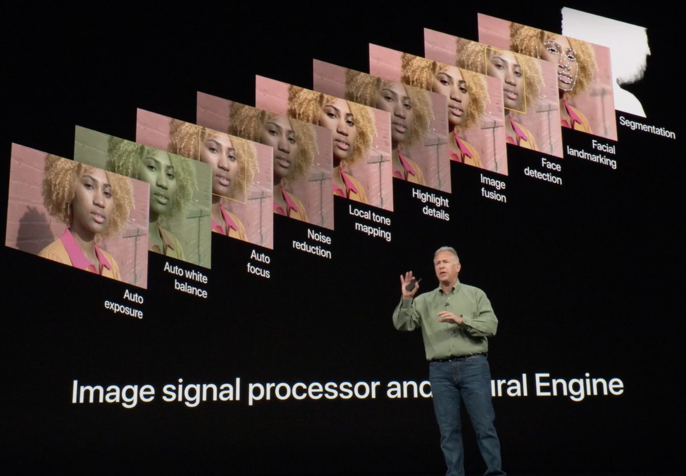
Deep Learning Application in iPhone XS
If you take a photo on iPhone X and XS, you run 3-4 neural networks on the hardware accelerator called Neural Engine
The neural networks are mostly used for
Segmentation
Key point detection
Face detection
…
They are becoming more and more popular in many mobile applications as well as in servers

Slide 11
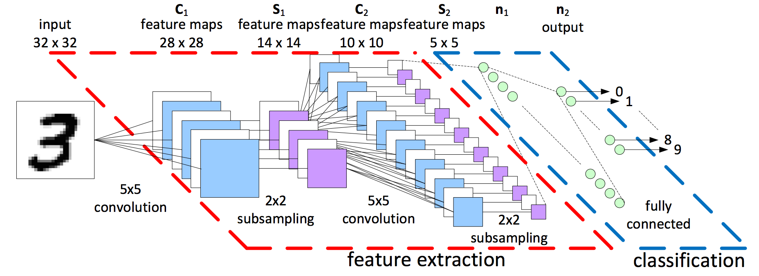
Our Application: Image Recognition Neural Network
Given an input image, recognize what is in it
Notes:
We study hardware system design with a deep learning application, by implementing it for a software/hardware co-design.
The neural network shown here takes as input a 32 pixel by 32 pixel image and classify 10 digits as output.
The neural network typically consists of feature extraction and task-specific output layers.
In this example, the network has two convolution layers (subsampling layers in between) as feature extractor
and a single fully connected layer for the digit classification.

Slide 12
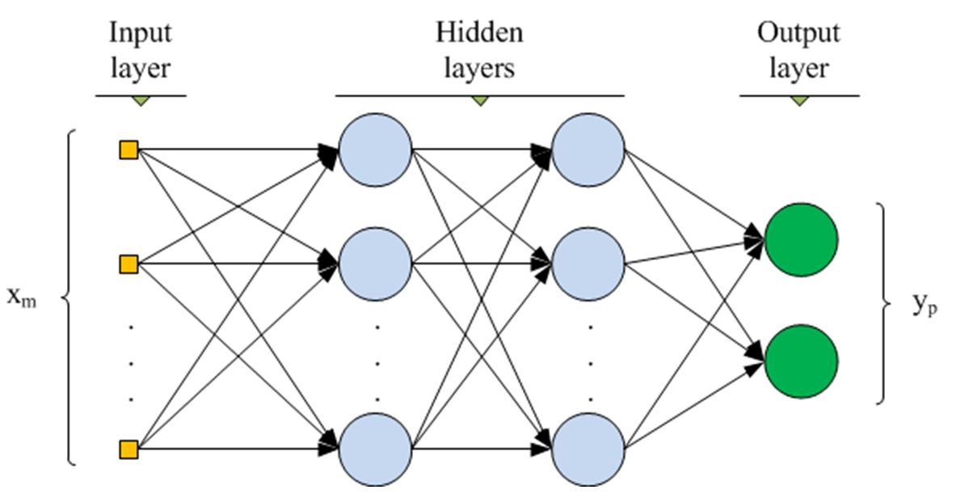
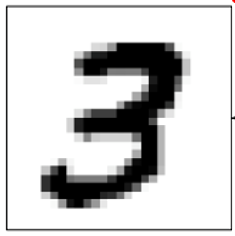
Multi-layer Perceptron (MLP)
Each layer consists of matrix-vector multiplication (MV)
MLP looks simpler than CNN (convolutional neural network). However, it is widely used in servers mostly for recommendation system and speech recognition [Google TPU 2017][MicroSoft Brainwave 2018]
Notes:
Multi-layer perceptron, MLP is the simplest neural network.
It consists of multiple fully connected layers.
In this example, the MLP has 3 layers.
The 2-dimensional image, e.g., 32x32 pixels is linearized to a vector, xm, e.g., a 1024-dimension vector obtained from 32x32 image.
The input vector element is multiplied by a weight on the arrow.
The output (circle in the slide) is obtained by summing the multiplication results.
Note that each arrow has its own distinct weight.
We obtain the weights by training the neural network.
We do not cover neural network training in our lecture.
For more details, refer to famous web resources like CS231n lecture.

Slide 13
Multi-Layer Perceptron
Each layer (M and N outputs) performs M*N multiplications between M inputs and associated weights (W) to give output
Output[i] = Σ_{j} Input[j]*W[i,j]
Output[0] = Σ_{j} Input[j]*W[0,j]
Output[1] = Σ_{j} Input[j]*W[1,j]
Output[2] = Σ_{j} Input[j]*W[2,j]
Output[255] = Σ_{j} Input[j]*W[N-1,j]
Notes:
The equations on the left shows the operations to obtain the output of a layer.
We assume we calculate an output vector of 256 dimension.
For instance, the first element of output vector, Output[0] is obtained by summing the multiplication results as the first equation shows.
W[0,j] represents the weight on the j-th arrow between j-th element of input vector, Input[j] and the output element, Output[0].

Slide 14
Multi-Layer Perceptron
Each layer (1024 inputs and 256 outputs) performs 1024*256 multiplications between 1024 inputs and associated weights (W) to give 256 outputs
Each layer performs M*V multiplication to give 256 outputs
Output[0] = Σ_{j} Input[j]*W[0,j]
W[0][0]
W[0][1]
W[0][2]
W[0][1023]
Input[0]
Output[1] = Σ_{j} Input[j]*W[1,j]
W[1][0]
W[1][1]
W[1][2]
W[1][1023]
Input[1]
Output[2] = Σ_{j} Input[j]*W[2,j]
W[2][0]
W[2][1]
W[2][2]
W[2][1023]
Input[2]
Output[255] = Σ_{j} Input[j]*W[N-1,j]
W[255][0]
W[255][1023]
Input[1023]
Notes:
A layer in MLP is realized by matrix-vector multiplication as exemplified in this slide.
Assume a layer having 1024 inputs and 256 output.
We need to multiply 256x1024 matrix and 1024-dim input vector to obtain 256-dim output vector.

Slide 15
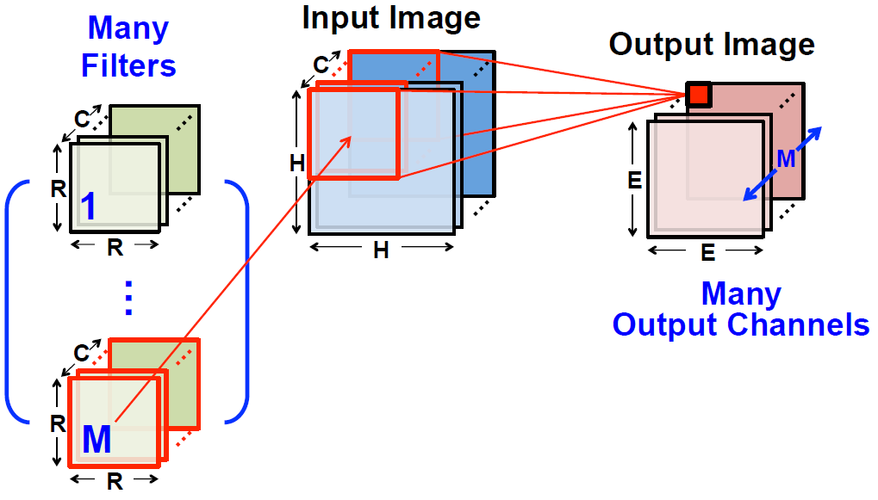
Convolution: 3D Input / 3D Output
[Chen, 2016]
Training (backprop) determines kernel weights
Notes:
In the case of convolution layer, we usually take as input 3-D input called 3-D tensor (Input Image in this example) and obtain 3-D output (on the right).
Each 2-D data is called channel or feature map.
In this example, the input tensor consists of C HxH channels while the output tensor M ExE channels.
Each output channel has its own kernel or filter, RxRxC tensor, shown on the left.
For instance, the M-th output channel has the kernel denoted with M on the left.
The kernel consists of kernel weights.
In this example, a kernel has RxRxC weights.
Those weights are obtained by training the neural network.
An output element (also known as neuron) is obtained by a dot product between its kernel and the corresponding input sub-tensor.
In this example, an output neuron (small red square on the M-th output channel) is obtained by performing a dot product
Between its kernel (a set of red rectangles at lower left of the slide) and the corresponding input sub-tensor (a set of red rectangles in the middle of the slide).

Slide 16
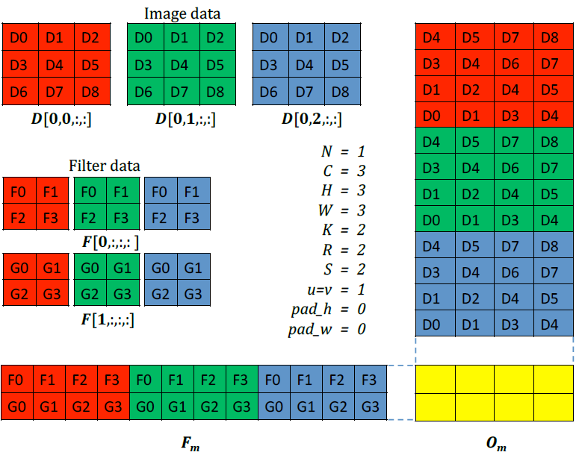
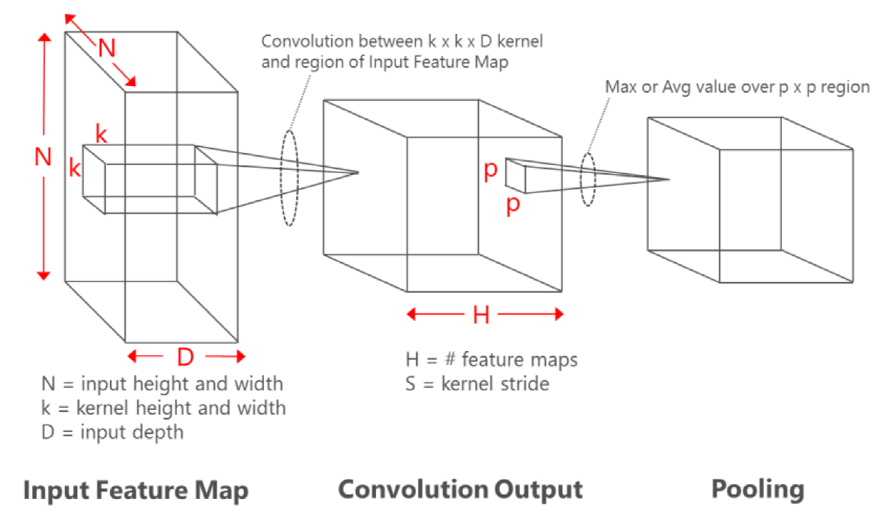
Convolution with Matrix-Matrix Multiplication (called Convolution Lowering) (W10)
[Chetlur 2014]
3: vertical dimension
Input: 3x3x3
Output: 2x2x2
Convolutional kernel: 3x2x2
2
3
2
3
2
2
2
3
2
2
2x2
2
Notes:
Convolution is often implemented by matrix-matrix multiplication as this slide shows.
At the lower left corner of the slide, we have 3x3x3 input tensor, 2x2x2 output tensor.
Each output channel of 2x2 has a 2x2x3 kernel.
In the middle of the slide, we can see the flattened input tensor (D[0,0,:,:], …) and kernel (Filter data).
On the right and bottom of the slide,
You can find the matrix versions of input tensor (right) and kernel (bottom).
By checking the color and notation, e.g., D4, D3, etc.,
You can easily find the correspondence between elements in input and kernel tensors and those in the matrices.
This slide has an animation.
In the animation, first, you can see dashed black boxes.
The data in the dashed black boxes on the flattened input tensor are mapped to a column of input matrix on the right.
You can see similar relationship between yellow boxes.
If we do dot product operation between a column of input matrix and a row of kernel matrix,
We can obtain an output neuron (a yellow square in 2x2 output matrix O_m).
As such, by multiplying the input and kernel matrices, we can obtain the output matrix, i.e., the flattened output tensor.
This technique of converting convolution to matrix multiplication convolution lowering and is widely used especially on GPU.
We will have a lab on convolution lowering in 10-th week.

Slide 17
Accelerating Matrix Multiplication with Dedicated Hardware Running in Parallel
Matrix-vector multiplication example
Hardware design computing
4 V*V operations in parallel
Matrix (M)
Vector (V)
CPU
x
x
x
x
+
x
+
+
+
+
Accumulator
Accumulator
Accumulator
Accumulator
Accumulator
16 cycles
4 cycles
Notes:
Typically, we have 10s~1000s input/output elements in a layer of MLP.
Thus, in case of 1000-dimension input/output, we need to perform 1000x1000 multiplications and additions to obtain a 1000-dimension output vector.
In other words, in order to compute an output element, we need to perform 1000 multiplications and additions.
As such, the neural network needs a large amount of multiplication and additions.
Thus, if we run a neural network on a typical CPU having only a few multipliers and adders,
the runtime will be very long.
Take the example of matrix-vector multiplication in this slide.
We assume the CPU has only one multiplier, adder and accumulator (a register) as shown in the center of the slide.
Assuming a multiplication takes a cycle and multiplication and addition are pipelined,
the M-V multiplication on the left will take at least 16 cycles since we need to do 16 multiplications and additions.
In addition, the CPU is not power-efficient.
Thus, the neural network execution on CPU will be very slow and power-consuming.
That is why we try to offload the multiplications and additions to the dedicated hardware implementation called hardware accelerator.
The hardware accelerator is designed mostly for parallel multiplications and additions to offer faster execution at lower power consumption than CPU and even GPU.
On the right, let’s assume that we have a hardware design which performs 4 multiplications in parallel.
This design will finish the MV operation in 4 cycles.
Parallel computation, though effective for speedup, needs careful designs.
First, we need multiple compute units. In this example, we need multiple sets of multipliers, adder and accumulator.
Second, we need to well distribute or map input/output data to the multiple compute units.
See the colors of input data on the four compute units on the right.
In our lecture and lab, we will study such hardware design issues.

Slide 18
Hardware (MV Accelerator) Design
X0XX0X0X
Vec
Matrix (M)
Vector (V)
Matrix
PE0
X0XX0XX
0X00X0X
PE1
x
x
PE0
PE1
+
+
Baseline Accelerator
computes multiple row*vector multiplications in parallel
Accumulator
Accumulator
Notes:
Specifically, in our lab and practice, we will design a hardware accelerator for matrix-vector multiplication (called MV accelerator).
On the left, we see the basic structure of MV accelerator consisting of two processing elements (PEs) and two memory components (one for matrix and the other for vector).
PEs have the same structure shown at the bottom right.
A PE consists of two inputs (registers), multiplier, adder, and accumulator register.
On the left of the slide, we see input data flow from memory components to PEs.
Multiple PEs run in parallel.
It is important to understand that, at each clock cycle, the memory components need to provide new data to PEs.
In addition, in this example, a single vector element is broadcast to two PEs as denoted by the yellow arrow.
Broadcasting exploits data reuse behavior on input vector and is one of fundamental method to reduce accesses to memory components.
Note that the design of this slide is just an example.
In your lab and term project, you can devise a better structure of MV accelerator on your own.

Slide 19
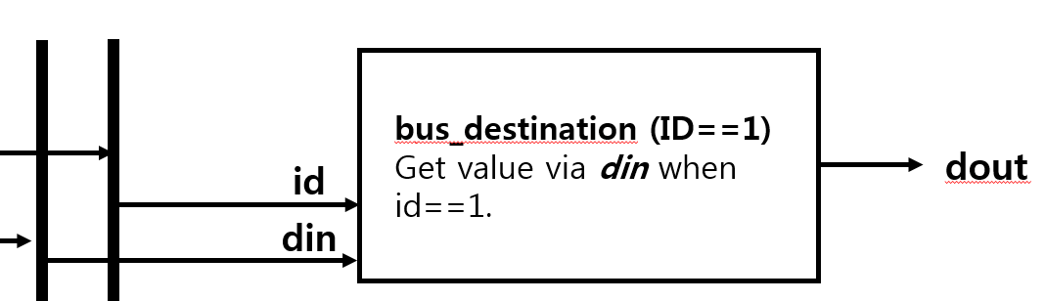
Verilog Coding for Baseline MV (W4-W8)
// a bidirectional bus example
module bus_destination (clk, rst, id, din, dout);
parameter ID=1;
input id;
input [31:0] din;
output [31:0] dout;
wire [31:0] internal_din;
wire en;
assign internal_din = (id==ID) ? din : 0;
assign en = (id==ID) ? 1 : 0;
MY_IP my_ip (
.clk(clk),
.rst(rst),
.en(en),
.din(internal_din),
.dout(dout)
);
endmodule
bus_destination
id
Id==1
my_ip
clk
rst
en
din
dout
0
din
Internal_din
Notes:
We design the MV accelerator in hardware design language, Verilog.
This slides shows an example of Verilog design.
Although some of you have already experience of Verilog design in your Logic Design class,
We review the Verilog coding because our design requires more knowledge and proficiency on Verilog design, especially, due to hardware synthesizability.

Slide 20
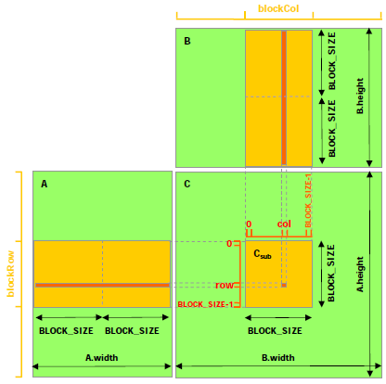
Blocking to Exploit Small On-Chip Memory
[CUDA Programming Guide, v7.5]
Divide matrix multiplication into small ones to meet the small capacity of on-chip memory or cache
For each small matrix multiplication, input data are reused multiple (BLOCK_SIZE) times
Typically, blocking targets scratch pad memory (e.g., shared memory on NVIDA SM)
CUDA C Programming Guide v7.5
Check the example in FIGURE 10 of “3.2.3 Shared Memory”
Notes:
Neural networks often require the multiplications of too large matrices to fit in the on-chip memory or cache of computing device such as CPU, GPU and even hardware accelerator.
In such a case, we adopt a well-known method called tiling or blocking
which divides output matrix and perform its computation in an incremental manner.
In the example of this slide from NVIDIA,
We divide output matrix C into smaller blocks.
In order to compute an output block (yellow rectangle on matrix C in the slide),
We read a sub-matrix, i.e, block of matrix A (the left-most yellow box on matrix A) from the main memory and store it in the on-chip memory or cache.
We also read a sub-matrix of matrix B (the top-most yellow box on matrix B) from the main memory and store it in the on-chip memory or cache.
We multiply the two sub-matrices to obtain a partial result of output sub-matrix.
Then, we read another sub-matrix of matrix A (the 2nd yellow box on matrix A) and another one from matrix B, multiply them and accumulate the result
with the current contents of the output sub-matrix, which finally gives the final result of the output sub-matrix.
For each output sub-matrix, we do the same procedure.
The benefit of blocking method is better data reuse than a simple multiplication of large matrices.
When we multiple two blocks, we reuse each input element, stored in on-chip memory, by BLOCK_SIZE times.
In other words, blocking can reduce the main memory accesses by BLOCK_SIZE times.

Slide 21
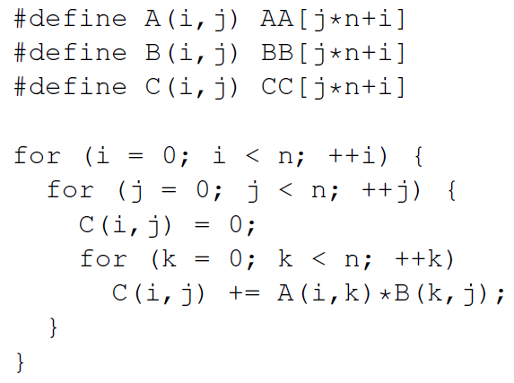
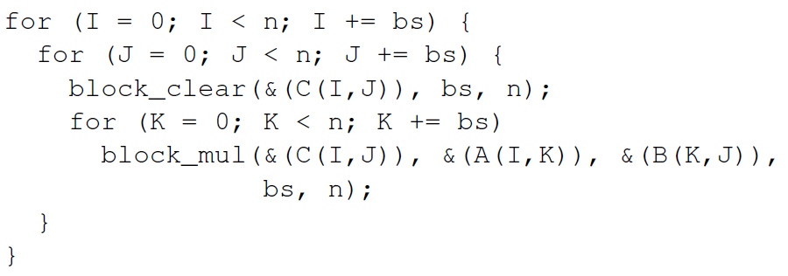
Blocking Code Example
[NVIDIA][http://www.cs.cornell.edu/~bindel/class/cs5220-s10/slides/lec03.pdf]
M*M multiplication case
Before blocking
After blocking
Notes:
This slide illustrates how the software code can be written for blocking.
We assume C = A*B where A, B, and C are nxn matrices.
On the left, we can see a typical C code for matrix multiplication.
On the right, we find a modified code for blocking.
As shown in the slide, function block_mul(…) is called to perform block by block multiplication.
In software implementation, function block_mul() will be a code of matrix-matrix multiplication similar to the one on the left.
In hardware implementation, however, function block_mul() calls a hardware accelerator while providing input data to the accelerator and receiving output from the accelerator, which is software-hardware communication.
We will do labs to study such a SW-HW communication.

Slide 22
Hardware/Software Design in Our Practice
ARM CPU runs the main function, i.e., the neural network which calls your MV hardware design for each block
MV for 8x8 weight matrix * 8-entry input vector multiplication
Memory, called BRAM is used for data transfer between SW and HW
One layer running on ARM processor
Xilinx Zynq (XC7Z020)
for(j=0; j<1024; j+=8) {
for(i=0; i<256; i+=8) {
Output[i] += Input[j]*W[i,j] + Input[j+1]*W[i,j+1] + …
Output[i+1] += Input[j]*W[i+1,j] + Input[j+1]*W[i+1,j+1] + …
…
Output[i+7] += Input[j]*W[i+7,j] + Input[j+1]*W[i+7,j+1] + …
}
}
Processing System
(PS, ARM Co-A9)
Programmable Logic
(PL, Xilinx Artix-7)
MV accelerator
Core #1
Matrix-Vector Multiplication Custom IP
Core #2
Memory interface
AXI master
BRAM
Notes:
This slides shows a bigger picture of software/hardware design in our practice.
Basically, we run the neural network code, main () on the ARM CPU.
The neural network code calls the MV multiplication function which is implemented by a hardware accelerator which we call MV accelerator.
On lower left of the slide, we see a C code corresponding to one layer of MLP.
Assume that the MV accelerator implements the function corresponding to the dashed blue box.
On lower right of the slide, we see the hardware structure consisting of ARM CPUs (two cores), Matrix-Vector multiplication custom IP (MV accelerator), and a memory block (BRAM).
Hardware/software design runs as follows.
The C code in the red box on the left runs on the CPU on the right.
When the C code calls a function corresponding to MV accelerator,
The MV accelerator on the right receives input data via BRAM, performs computation, and stores the output on BRAM.
The C code on ARM finally reads the output from BRAM and continues its execution.
In hardware/software design, the communication between SW and HW is often performed using a memory, BRAM in this case.
Note that we use FPGA which consists of ARM CPU and programmable hardware logic area where we implement our MV accelerator.

Slide 23
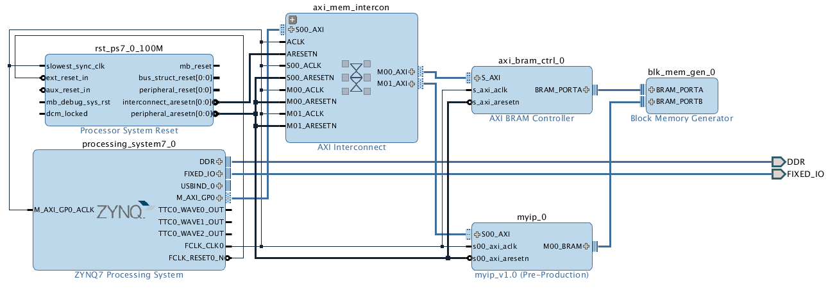
Software-Hardware Communication on FPGA (W11)
Input / Output Block
Command
Notes:
This slides shows a schematic design which is a detailed version of the hardware structure in FPGA shown in the previous slide.
Hardware components are connected to each other.
Processing_system has ARM CPU.
Axi_mem_interconn is the bus which connects most of hardware components.
Axi_bram_ctrl and blk_mem_gen comprise an on-chip memory for SW/HW communication for input and output of MV accelerator.
Myip is the MV accelerator.
In your lab and project, you will build your own hardware architecture using a schematics like this one.

Slide 24
Hardware (MV Accelerator) Design and Optimization
skip
skip
X0XX0X0X
X0XX0X0X
Act
Vec
PE0
Weight
PE0
Matrix
X0XX0XX
0X00X0X
X0XX0XX
0X00X0X
PE1
PE1
Baseline Accelerator
computes multiple row*vector multiplications in parallel
Zero-skip Accelerator
reduces runtime by skipping zero-input multiplications
Notes:
In our lab, we will try to improve the baseline MV accelerator by exploiting optimizations.
This slide shows how we improve the accelerator by zero skipping.
Zero skipping is to skip multiplication in the case that one of input operands is zero.
By doing that, we can save runtime and energy consumption.
In neural networks, there can be many zero weights and neurons.
In such a case, zero skipping can be powerful to reduce runtime and energy consumption.

Slide 25
Design Optimizations (W12-W14)
Direct memory access (DMA)
DMA allows MV accelerator to directly access main memory without CPU intervention (e.g., without moving data to CPU registers)
Reduced precision, e.g., 8-bit computation instead of 32-bit one
8-bit computation does not lose accuracy with respect to 32-bit one
8-bit neural network will be provided
Zero skipping
ReLU activation makes ~50% of activations zero data
MV accelerator will skip multiplications for zero input thereby reducing runtime
Notes:
There are other optimization chances.
Direct memory access, DMA is a traditional method to improve communication between hardware components including CPU and hardware accelerator.
Reduced precision is another idea to optimize neural network design since neural networks tend to require lower precision like 8 bits than typical scientific programs which often need 32 or 64bit data.
In our labs, we will cover these representative optimization methods.

Slide 26
Reality Check
Ours is a practice example of undergraduate class. How much realistic is it?
Let’s try to compare ours with Google’s, Apple’s or Samsung’s solutions for neural network acceleration
Scale is different: 10X ~ 100X in # multipliers, 100X ~ 1000X in performance
Our design will be equipped with ~100 multipliers running at ~50MHz
Google’s TPUv1 has 64k multipliers @ >500MHz
Apple’s Neural Engine (on iPhone XS) may have 4k multipliers @ >500MHz
Samsung’s NPU (probably on Galaxy S10) has 1k multipliers @ >500MHz
However, the basic structure is similar
Parallel multiplication
In addition, key optimization ideas can compete with them
Reduced precision
8 bits are used in Google’s TPUv1, Apple’s Neural Engine (iPhone XS), and Samsung’s NPU (Galaxy S10)
Zero skipping
Only Samsung NPU supports zero-skipping acceleration

Slide 27
Summary of Class Overview
Class goal: Understanding hardware/software system design methods by studying/practicing key issues such as
Running an application on hardware (FPGA)
Hardware design to accelerate functions
Further optimizations, e.g., DMA, reduced precision, zero skipping, …

